Slide 1
Connecting and manipulating Database with Python
Session 4a

Slide 2
Objectives
Database manipulating with Python
CRUD Operations with Python
Connect SQLite, SQL Server, MariaDB

Slide 3
Python database
The Python standard for database interfaces is the Python DB-API. Most Python database interfaces adhere to this standard.
You can choose the right database for your application. Python Database API supports a wide range of database servers such as −
  GadFly
  mSQL
  MySQL
  PostgreSQL
  Microsoft SQL Server 2000
  Informix
  Interbase
  Oracle
  Sybase
Here is the list of available Python database interfaces: Python Database Interfaces and APIs. You must download a separate DB API module for each database you need to access. For example, if you need to access an Oracle database as well as a MySQL database, you must download both the Oracle and the MySQL database modules.

Slide 4
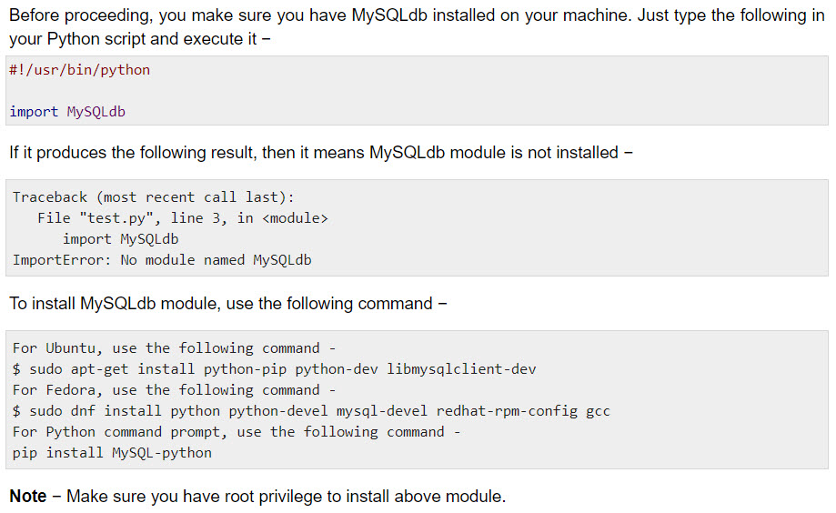
How do I Install MySQLdb ?

Slide 5
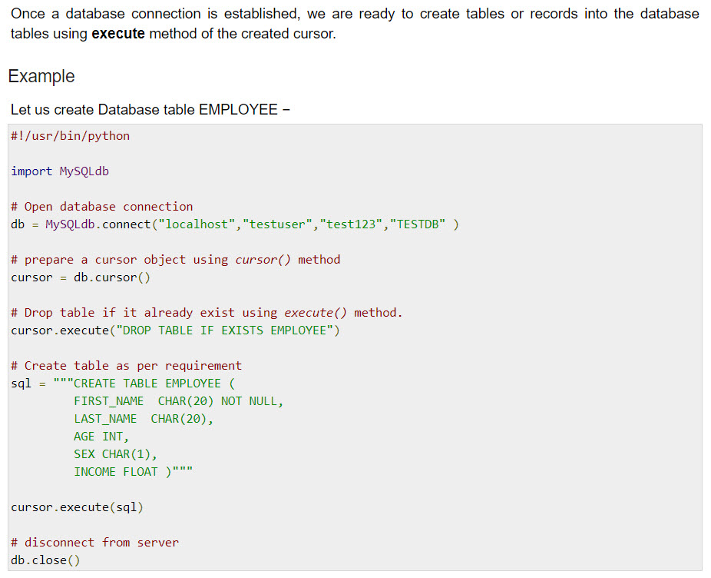
Creating Database Table

Slide 6
READ Operation
READ Operation on any database means to fetch some useful information from the database.
Once our database connection is established, you are ready to make a query into this database. You can use either fetchone() method to fetch single record or fetchall() method to fetech multiple values from a database table.
  fetchone() − It fetches the next row of a query result set. A result set is an object that is returned when a cursor object is used to query a table.
  fetchall() − It fetches all the rows in a result set. If some rows have already been extracted from the result set, then it retrieves the remaining rows from the result set.
  rowcount − This is a read-only attribute and returns the number of rows that were affected by an execute() method.

Slide 7
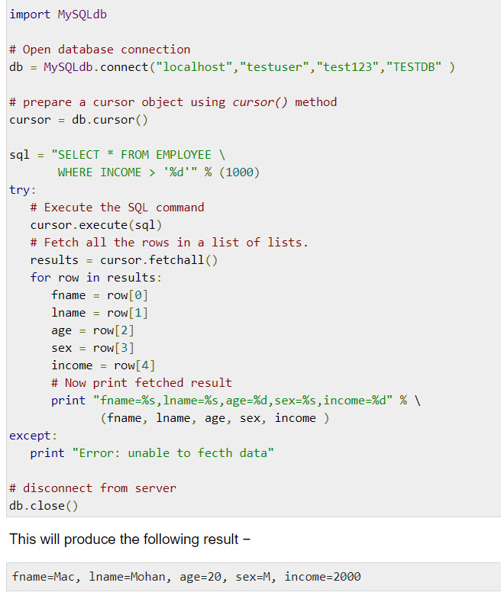
READ Operation

Slide 8
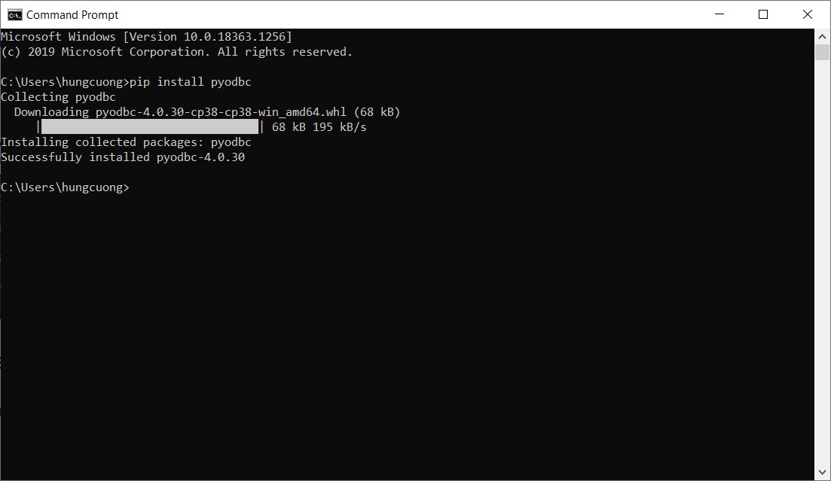
Connect to SQLServer using Python

Slide 9
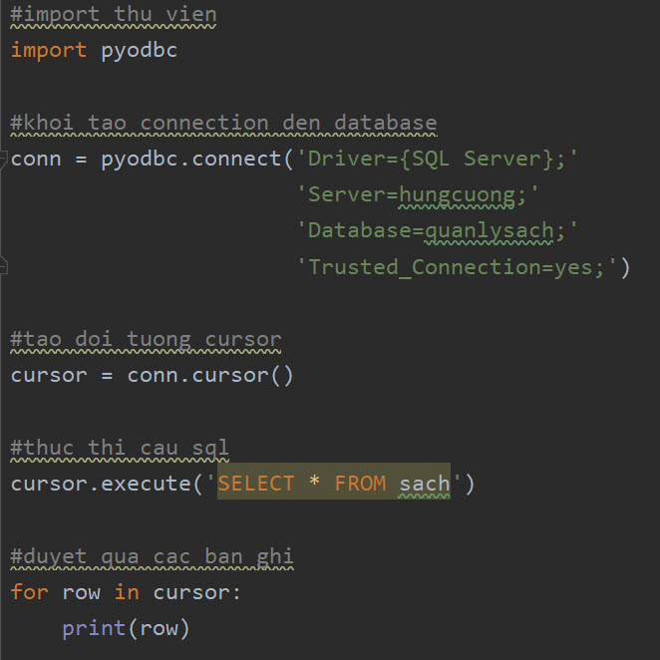
Connect to SQLServer using Python

Slide 10
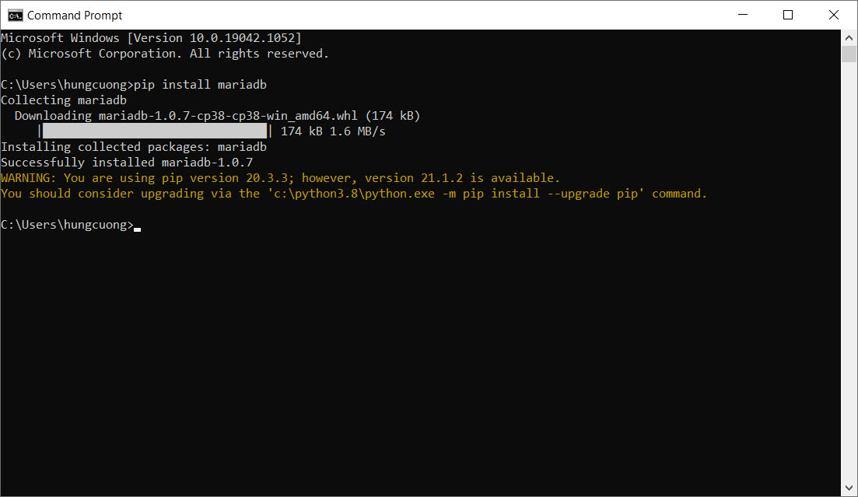
Connect to MariaDB using Python

Slide 11
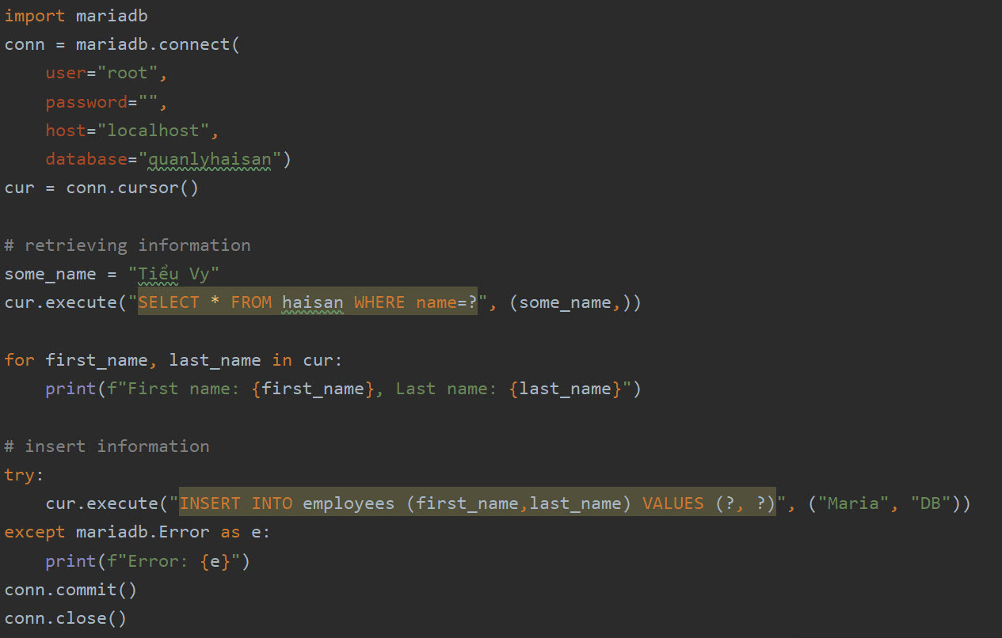
Connect to MariaDB using Python

Slide 12
Summary
Database manipulating with Python
CRUD Operations with Python
Connect SQLite, SQL Server, MariaDB

Slide 13
TRAO ĐỔI CHIA SẺ
Q & A

Slide 14

KHÁCH HÀNG CỦA CHÚNG TÔI

